Slide 1


DEVELOPMENT OF A PYTHON FLASK-BASED WEB APPLICATION FOR SECURE USER AUTHENTICATION AND DYNAMIC QUIZ MANAGEMENT WITH MONGODB INTEGRATION
This project involved developing a comprehensive web application using Python's Flask framework, MongoDB for data management, and various security measures for user authentication and authorization.
JAIKISHORE (192210185)
SIVASABARIRAJAN(192210292)

Slide 2

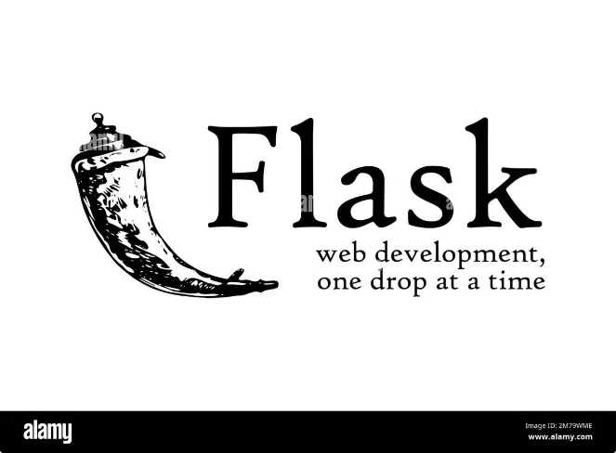
Introduction
The purpose of this project was to create a user-friendly and secure online platform for administering and taking quizzes.
1
Web Application
The core of the project is a web application built using Python's Flask framework. Flask is known for its lightweight and flexible nature, making it suitable for developing web applications of varying complexity.
2
Quiz Management
The application provides a robust system for managing quizzes. This includes creating, editing, and deleting quizzes, as well as managing questions and answers within each quiz.
3
Secure Authentication
A secure authentication system was implemented to ensure that only authorized users can access the application's features. This includes features like registration, login, and password recovery.
4
MongoDB Integration
MongoDB, a popular NoSQL database, was chosen for its scalability and flexibility in handling dynamic data. It effectively stores and manages user information, quiz details, and user responses.

Slide 3
Abstract
This paper presents the design and development of a Python Flask-based web application focused on secure user authentication and dynamic quiz management. The application leverages MongoDB as its database system, ensuring efficient data storage and retrieval.
Functionality
Security
Technology
The application provides a range of features, including user registration and login, quiz creation and management, and dynamic quiz-taking functionality.
Security is a paramount concern, with measures implemented to protect user data and prevent unauthorized access. This includes secure password hashing, session management, and input validation.
The project employs Python's Flask framework, a popular choice for web development, along with MongoDB, a robust NoSQL database, for efficient data handling.

Slide 4

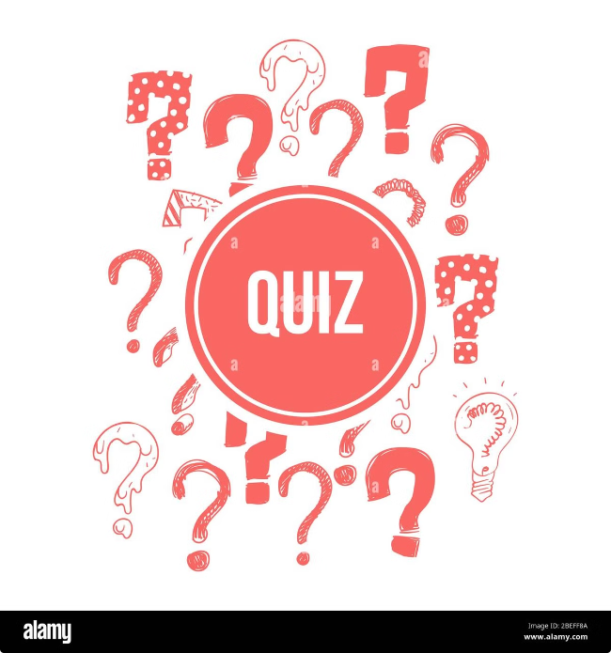
Objective
The primary objective was to develop a fully functional web application capable of securely managing quizzes and providing a user-friendly experience.
User-Friendly Interface
The application's interface was designed with ease of use in mind, making it accessible to a wide range of users.
Secure User Authentication
A secure authentication system was implemented to protect user data and prevent unauthorized access.
Dynamic Quiz Management
The application provides flexibility in managing quizzes, allowing users to create, edit, and delete quizzes with ease.

Slide 5

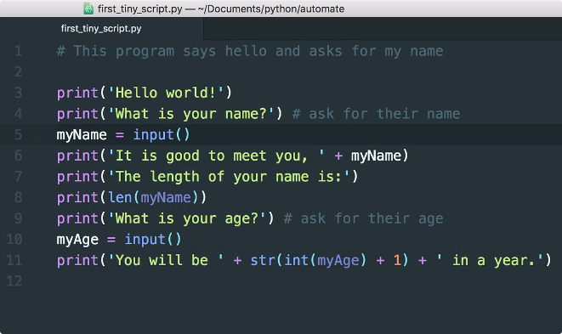
Methodology
The development process involved a series of steps, beginning with requirements gathering and analysis and culminating in testing and deployment.
1
Requirements Gathering
This stage involved understanding the specific needs and functionalities of the application, taking into account user requirements and security considerations.
2
Design and Development
Based on the gathered requirements, the application was designed using Python's Flask framework and integrated with MongoDB for data storage.
3
Testing and Deployment
After development, the application underwent rigorous testing to ensure functionality, security, and usability. Once deemed ready, the application was deployed on a suitable web server.

Slide 6

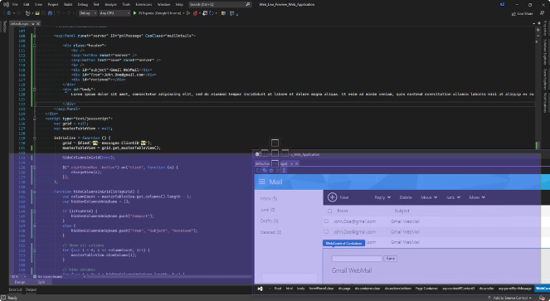
Result and Discussion
The project successfully delivered a functional web application capable of managing quizzes securely and efficiently. The application utilizes the Flask framework, MongoDB, and various security features to provide a user-friendly and secure platform.
Feature
Description
User Authentication
Secure login and registration functionalities were implemented to protect user accounts and data.
Quiz Management
Users can create, edit, and delete quizzes with ease, including adding and managing questions and answers.
Dynamic Quiz-Taking
The application provides a dynamic and interactive experience for users taking quizzes.
Data Storage
MongoDB's scalability and flexibility ensure efficient storage and retrieval of user data, quizzes, and user responses.

Slide 7





Conclusion
This project successfully developed a web application for managing quizzes with secure user authentication and dynamic functionalities. The application utilizes the Flask framework, MongoDB, and various security measures to provide a user-friendly and reliable platform.
Functionality
Security
Data Management
User Experience
The application fulfills the objectives of providing a user-friendly platform for creating, managing, and taking quizzes.
Security is a key aspect of the application, with robust measures in place to protect user data and prevent unauthorized access.
MongoDB's efficient data storage and retrieval capabilities enable the application to handle large amounts of data seamlessly.
The application provides a user-friendly interface, making it easy for users to navigate and interact with its features.

Slide 8


References
This project draws inspiration from various resources, including documentation on Flask, MongoDB, and security best practices.
Flask Documentation: https://flask.palletsprojects.com/en/2.2.x/
MongoDB Documentation: https://www.mongodb.com/docs/
OWASP Security Guide: https://owasp.org/www-project-top-ten/

Slide 9





Acknowledgements
The successful development of this project was made possible by the contributions of various individuals and resources.
Course Faculty
Thanks to the guidance and support of mentor who provided valuable insights and direction throughout the project.
Online Resources
Numerous online resources, including tutorials, documentation, and forums, provided essential information and solutions during development.
Collaborators
Collaboration with fellow developers facilitated knowledge sharing, problem-solving, and the overall improvement of the project.

Slide 10


Future Work
The application can be further enhanced by incorporating additional features and functionalities.
1
Advanced Security Features
Implementing two-factor authentication, role-based access control, and other advanced security features can further enhance user security.
2
Mobile Optimization
Optimizing the application for mobile devices can improve accessibility and user experience for users accessing the application on smartphones or tablets.
3
Integration with Learning Management Systems
Integrating the application with existing learning management systems (LMS) can streamline the quiz management process and enhance its utility in educational settings.

